Slide 1
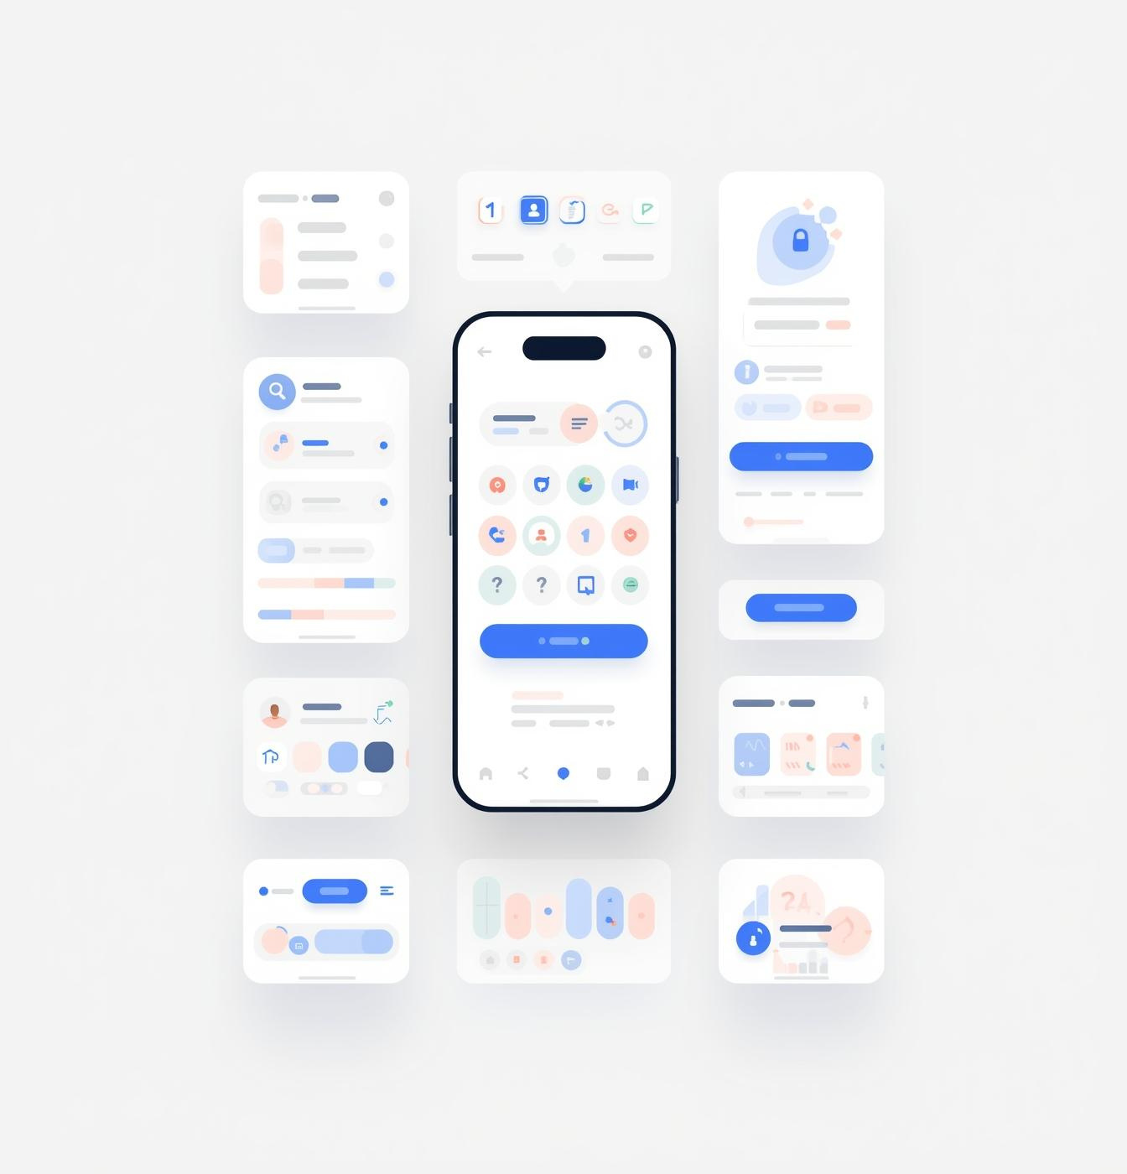

UI/UX Redesign Presentation
Egypt’s Trains
Mobile Application
Team members
1) Amira Khamis Hendawy Khamis Aboswied
2) Asmaa Ahmed El-sayd Mohamed Eisa
3) Esraa Fawzy El-sayd Abdelkader

Slide 2
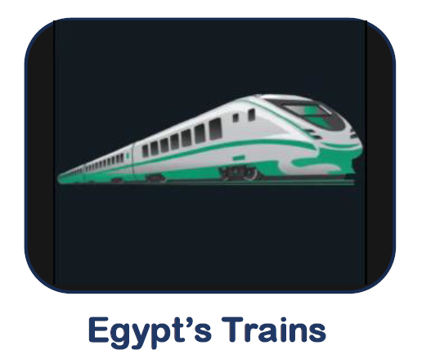
Introduction
Egypt’s Trains is a mobile app to search train trips across Egyptian cities.
Our goal was to redesign it using HCI principles to make it easier and more enjoyable to use.

Slide 3

Project Goals
•Improve usability and clarity
•Reduce user effort and cognitive load
•Create a smooth and intuitive search flow
•Enhance the overall user experience

Slide 4
Old Design Problems
Overview of Design Issues
Overcrowded layout makes the interface hard to use
Poor color contrast reduces text and content visibility
Inconsistent icons cause confusion
Navigation is unclear and difficult to follow
Important elements are not visually clear
Weak visual hierarchy

Slide 5
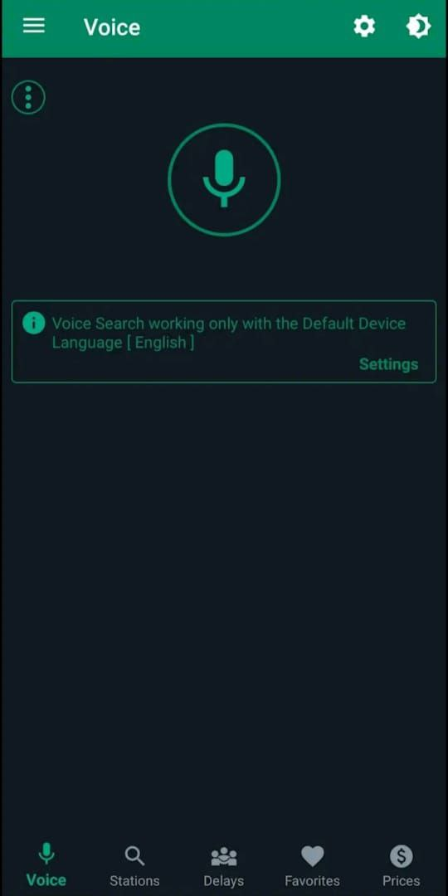
Old Design
Problems of the voice Page
•No home screen, the app opens directly on the Voice page
• No clear instructions on how to use voice search
• Weak visual hierarchy, important elements are not highlighted
• The purpose of the page is not clear to users
• Poor color contrast makes text hard to read
• Large empty space with no useful content

Slide 6
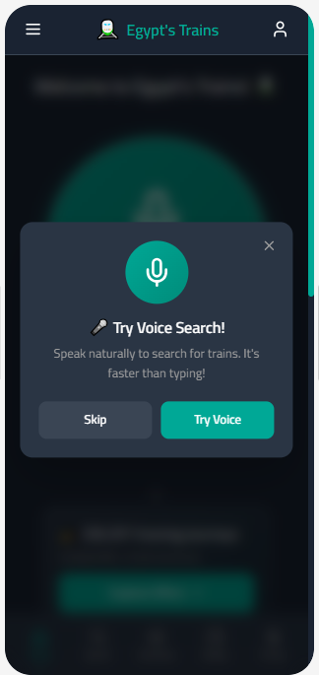
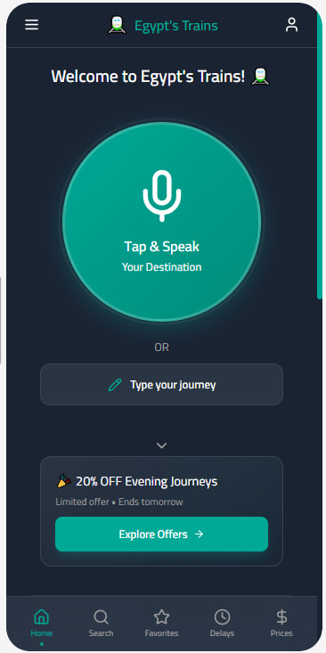
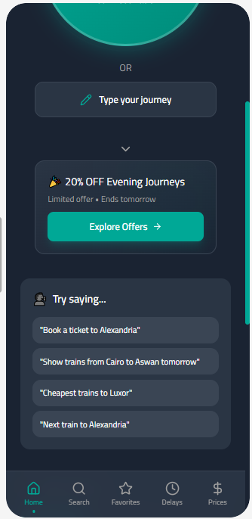
New Design

Slide 7
New Design
Key Improvements
- Much Better User Experience
- Home screen helps users know where to start
- Easy to understand and use
- Using comfortable colors that relax the eyes and guide users’ attention to key actions.
- Clean layout with clear focus on microphone/speech
- Option to use voice or type the destination
- Navigation is consistent across screens

Slide 8
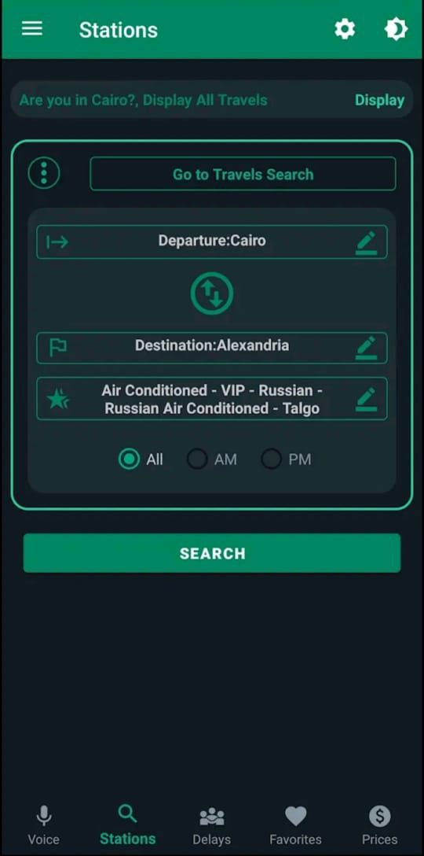
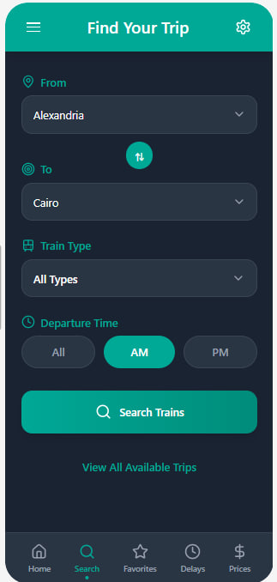
Old Design New Design

Slide 9
Old Design
Problems of the stations page
Visual Overload: Too many borders, glowing effects, and heavy shadows.
Weak Visual Hierarchy: Important actions (Search, Departure, Destination) were not clearly prioritized.
The screen name doesn’t reflect its actual functionality
Complex Layout
Inconsistent Components: Icons, buttons, and input fields lacked consistency.
Poor Readability: Dark background combined with neon colors reduced text clarity.

Slide 10
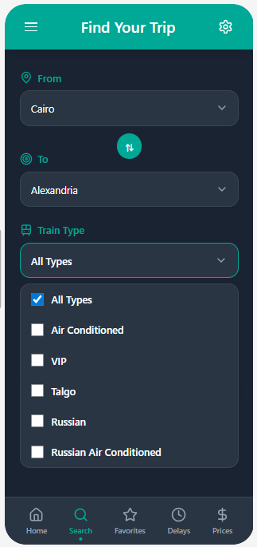
New Design
Key Improvements
-Much better user experience
-Layout is clean and organized
-Users don’t have to think too much
-Interactions are simple and user-friendly
-Primary actions are easy to find
-The search button is more clearly visible.
- Better spacing and alignment enhance readability.

Slide 11
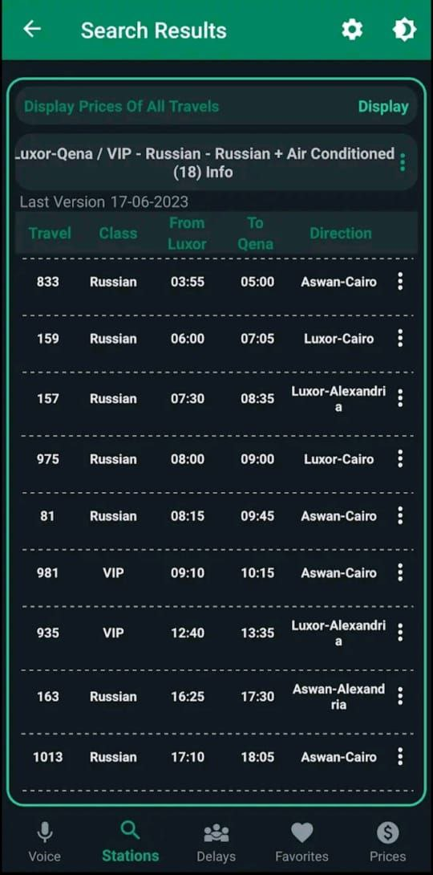
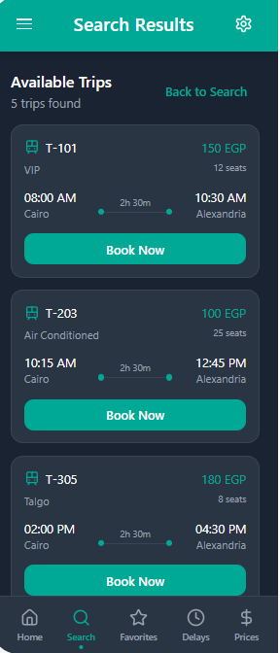
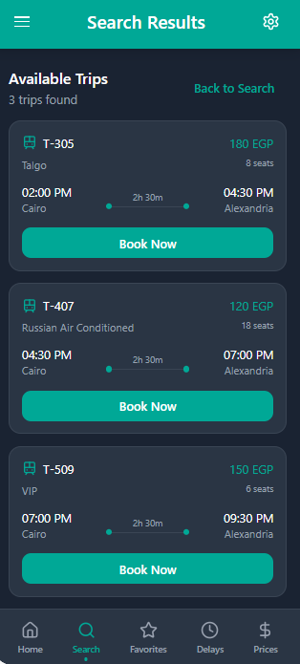
Old Design New Design

Slide 12
Old Design
Problems
-Too much information: Hard for users to find what they need.
- Important info not clear: Time and class are not easy to see.
- Hard to read: Small text and dark background tire the eyes.
- Actions are hidden: Users can’t find buttons easily.
- Too much thinking needed: Users must check many columns to decide.

Slide 13
New Design
Key Improvements
Easy to scan: Every trip is in its own clear box.
Important info first: Price and seats shown at the top.
Quick to compare: All trips look the same, easy to check differences.
Clear times: Big, bold times show exactly when the train leaves and arrives.
Simple booking: Big "Book Now" button under every trip.
Easy to count: "3 trips found" tells you immediately how many options you have.
Easy to go back: "Back to Search" button if you want to change something.
The overall user flow is smoother and faster
Easier to read - cards better than tables

Slide 14
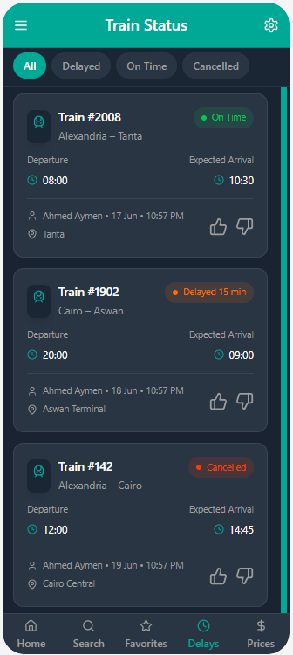
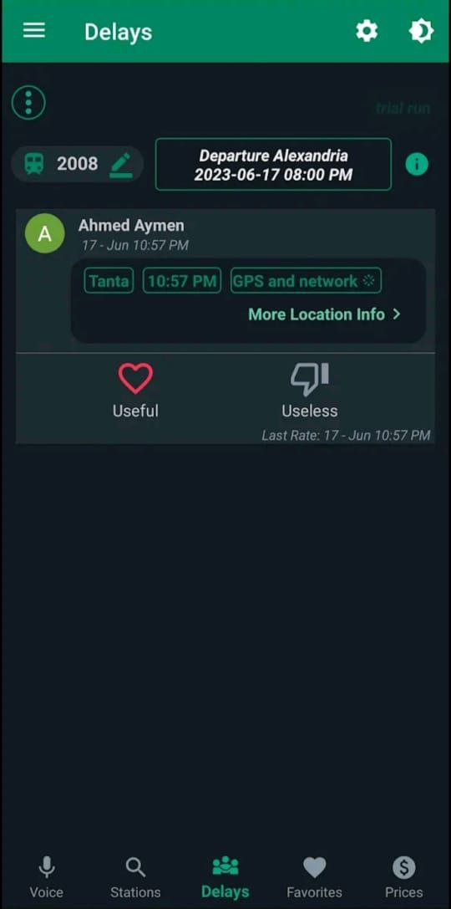
Old Design New Design

Slide 15
Old Design
Problems
Inconsistent layout and formatting (mixed fonts, alignment issues).
Poor organization of information; sections not logically grouped.
Confusing or unclear data (unlabeled numbers, ambiguous tables).
Ineffective interactive elements or missing feedback.
Navigation disorganized and inconsistent.
inconsistent formatting

Slide 16
New Design
Key Improvements
Clear and organized layout with strong visual hierarchy.
Interactive elements visible and intuitive (checkboxes, confirm selection).
Logical grouping of information and sections.
Consistent formatting and language.
Easy to read, compare, and understand key data.
Navigation aligned and visually separated.
Helpful notes and feedback sections.

Slide 17
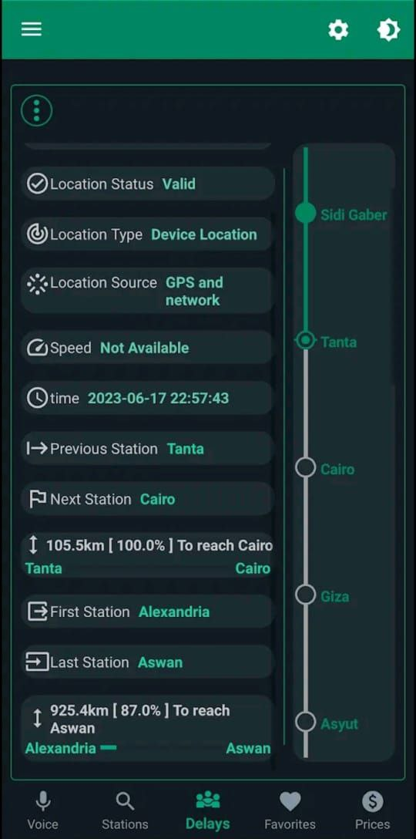
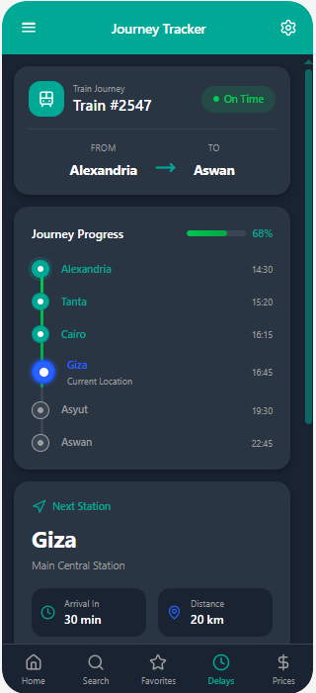
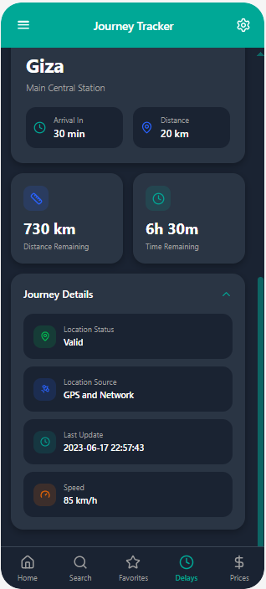
Old Design New design

Slide 18
Old Design
Problems
Weak visual hierarchy with no clear distinction between elements.
Poorly organized and crowded content.
Unclear data presentation with high text density.
Lack of separators and visual grouping.
Weak user experience that requires extra effort

Slide 19
New Design
Key Improvements
Clear visual hierarchy that highlights important information.
Well-organized content with logical sections and proper spacing.
Easy and clear data presentation using labels and visual elements.
Information arranged by priority for quick access.
Smooth, professional, and user-friendly experience

Slide 20
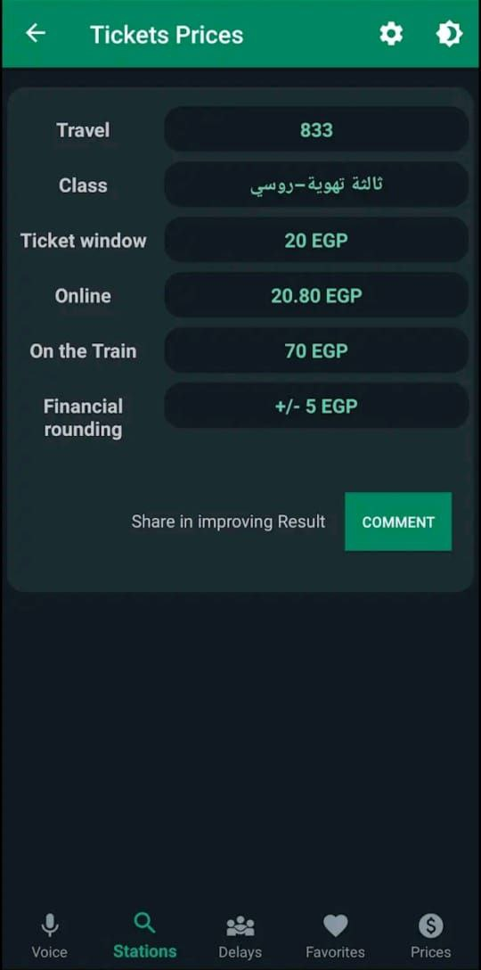
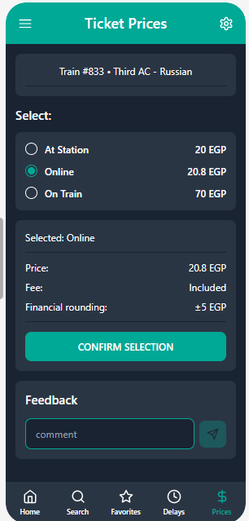
Old Design New Design

Slide 21
Old Design
Problems
Inconsistent layout and alignment.
Poor and illogical information organization.
Unclear interaction with no selection or confirmation feedback.
Disorganized navigation and inconsistent formatting.
Mixed language and price formats.
Weak and tiring user experience.

Slide 22
New Design
Key Improvements
Clear visual hierarchy and structured headings.
Intuitive interaction with clear selection and confirmation.
Well-organized information with grouped options and summary.
Consistent language, spacing, and price formatting.
Clear and organized navigation.
Better overall user experience.

Slide 23
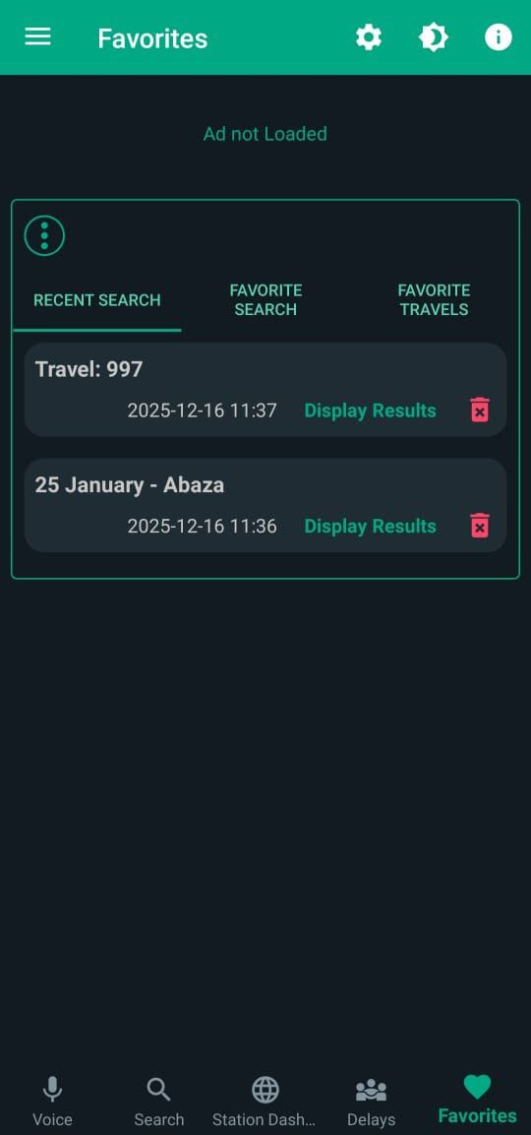
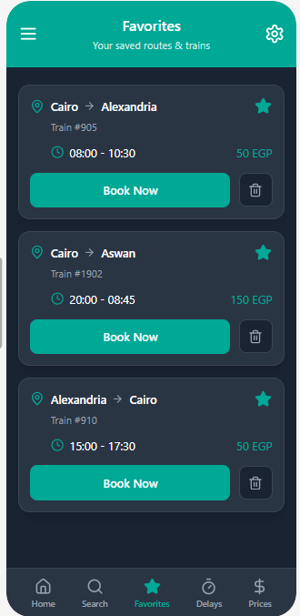
Old Design New Design

Slide 24
Old Design
Problems
Text-heavy interface that is hard to scan quickly.
Lack of clear interactive elements for booking or selection.
Poor visual hierarchy with minimal formatting.
Journey details (time, train number) are not clearly highlighted.
Overall design feels outdated and less user-friendly.

Slide 25
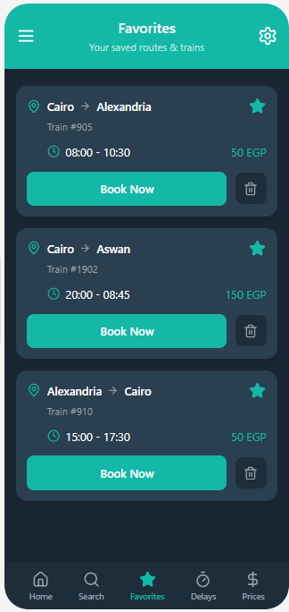
New Design
Key Improvements
Clear and well-structured layout with separated journey blocks.
Visible interactive elements such as Book Now buttons and checkboxes.
Better visual timeline showing departure and arrival times.
Modern and attractive design with proper spacing and typography.
Booking status clearly displayed for each journey.

Slide 26
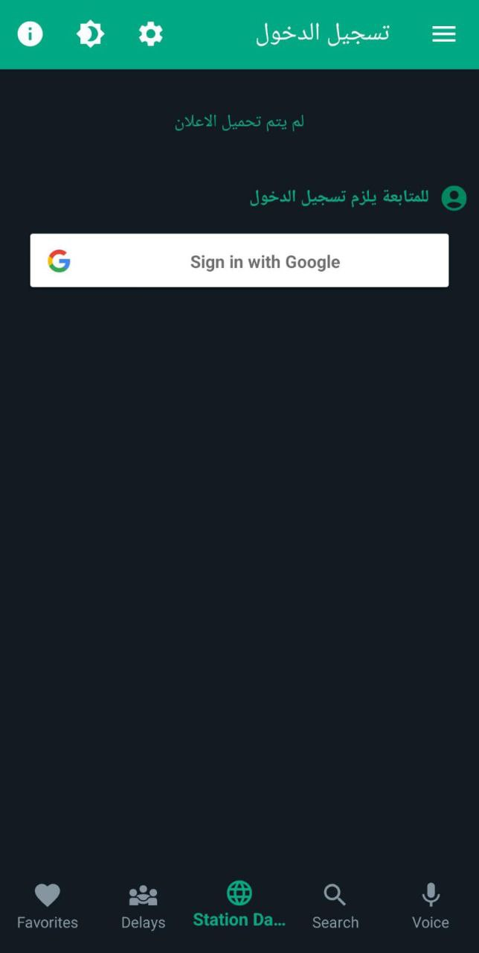
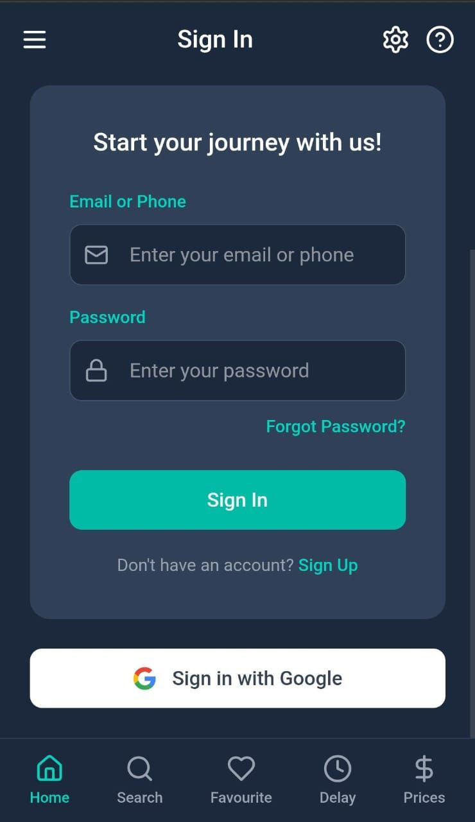
Old Design New Design

Slide 27
Old Design
Problems
Limited Login: Only Google sign-in; no sign-up or recovery options.
Weak Layout: Disorganized elements and excessive empty space.
​Poor Aesthetics: Unbalanced colors and inconsistent language (Arabic/English).

Slide 28
New Design
Key Improvements
Flexible Access: Added Email, Phone, and Google login options.
​Full User Flow: Included "Sign Up" and "Forgot Password" features.
​Clean Card UI: Grouped elements into a focused, centered card design.
​Optimized Layout: Removed empty spaces for better focus.
​Unified Language: Standardized to English for a professional, global feel.

Slide 29
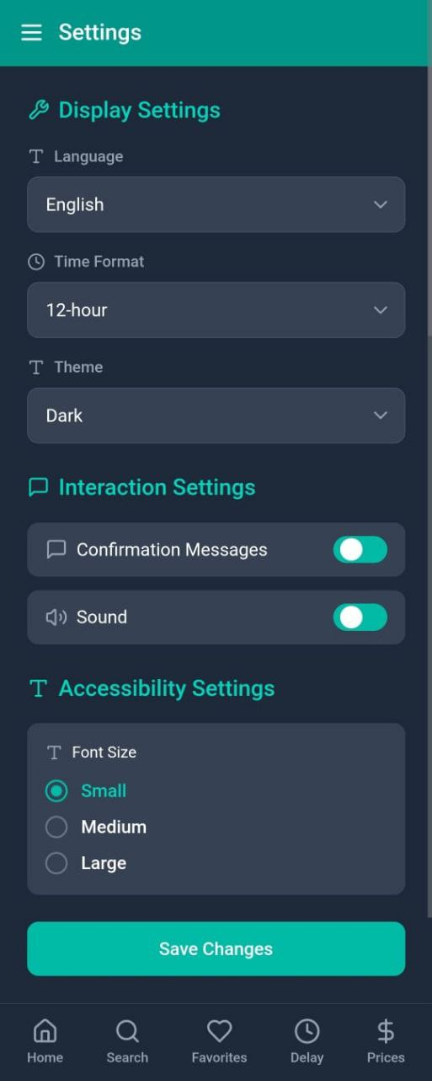
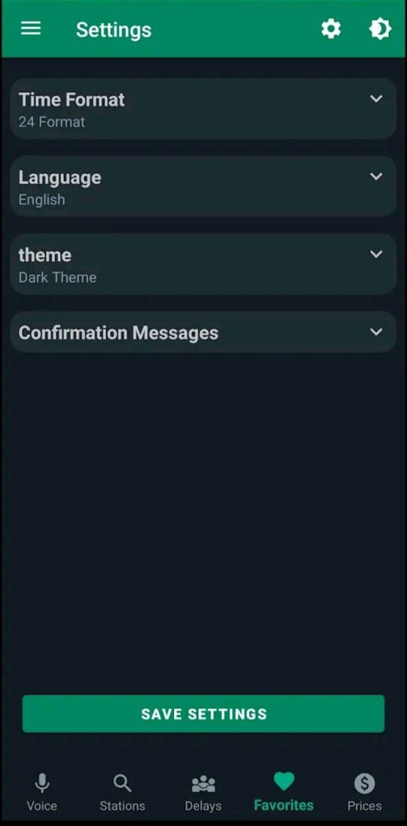
Old Design New Design

Slide 30
Old Design
Problems
• Inefficient Inputs: Used dropdowns for simple "Yes/No" choices.
​High Friction: Too many clicks required for basic settings.
​Text-Heavy UI: Lack of icons makes navigation slow and boring.
​Cluttered Header: Too many unnecessary icons in the top bar.
​Poor Scaling: Ineffective use of available screen space.

Slide 31
New Design
Problems
. ​Smart Grouping: Organized settings into clear categories.
• ​Direct Access: Visible options and toggles instead of hidden menus.
• ​Enhanced Visuals: Added icons and a clear "Save" button.
• Clean Layout: Simplified header and better use of screen space

Slide 32
Impact of Redesign
Tasks completed faster
Fewer errors and confusion
Less mental effort
A more comfortable, professional feel

Slide 33
Conclusion
• The redesigned Egypt’s Trains app is clearer, easier, and
faster to use.
Applying HCI principles improved both usability and overall experience compared to the old design.

Slide 34
Thank You!

